Slide 1
Building a Serverless Discord bot in Azure Functions
The PoSh Wolf
https://github.com/theposhwolf/sessions

Slide 2
Who is The PoSh Wolf?
Anthony Howell
From Eugene, OR USA so, according to ChatGPT, I am:
Progressive, outdoorsy, creative, friendly, and open-minded
~3.3 kids, 2 dogs, 1 wife, 1 cat
In IT since 2011
Blogger (https://theposhwolf.com)
Twitter (https://twitter.com/theposhwolf)
Pluralsight author (https://pluralsight.com)
Consulting (https://howell-it.com)
Employed

Slide 3
Overview
Purpose and goals
Discord slash command process explanation
Function Chaining
Azure Function workflow
Creating a Discord bot
Avoiding frostbite
The code itself
Command addition process

Slide 4
Why?
Background
Money
Electricity is expensive
Azure VMs bill based on consumption
Azure Functions bill based on consumption
Professional Development
Coolness factor

Slide 5
Goals
Discord Bot
Azure Based
Inexpensive
Fast
PowerShell

Slide 6
Prerequisites
PowerShell
Discord Developer account
Azure Subscription

Slide 7
Demo Environment
Windows 10
VS Code (latest version)
PowerShell 7.2 (Azure Function)
Discord.Net.PowerShell

Slide 8
Discord Slash Commands

Slide 9
Slash command demo…

Slide 10
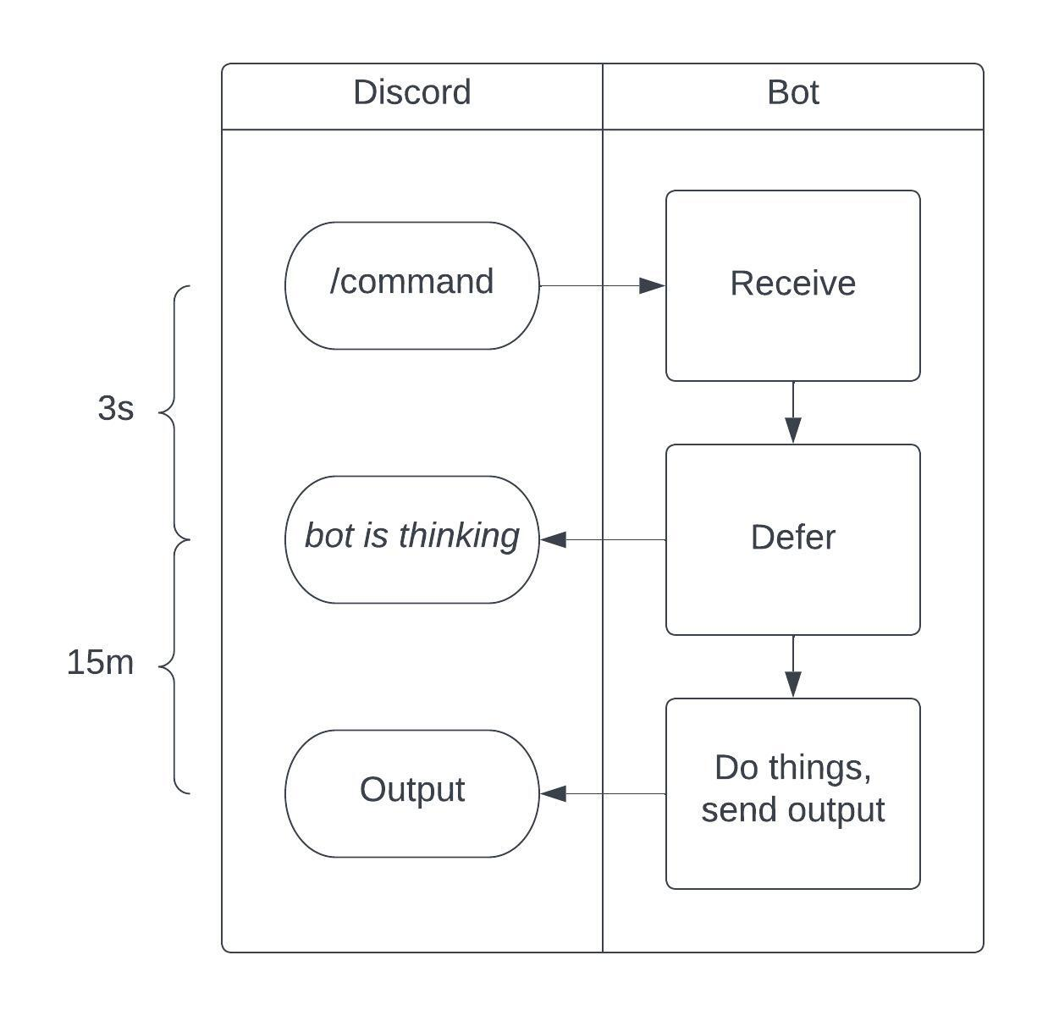

Slide 11
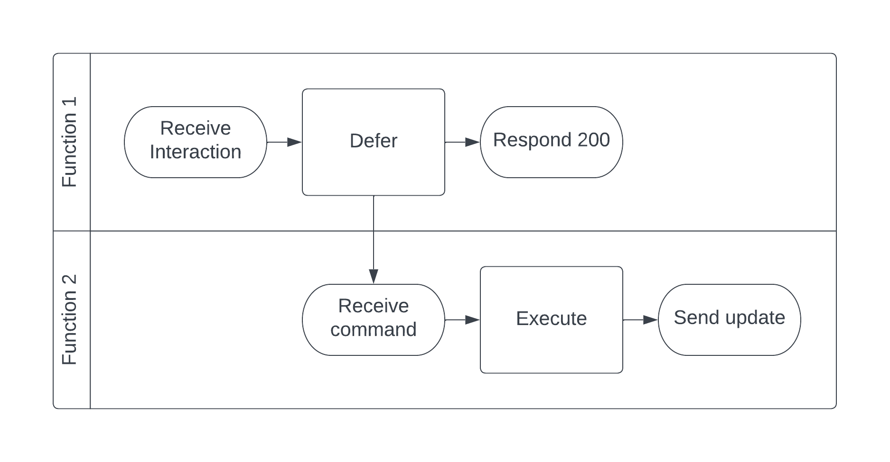
Function Chaining

Slide 12
Function Chaining Evolutions
Queue based
Building a Discord Bot in PowerShell and Azure Functions
Devin Rich
Command is passed off via a queue
Slower, but more reliable than HTTP POST chain
Durable Function
Command is passed off via New-Orchestration
Very storage intensive (expensive)
HTTP POST chain
Command is passed off via HTTP POST
Fast, but requires function keys and -TimeoutSec

Slide 13
Azure Function Workflow

Slide 14
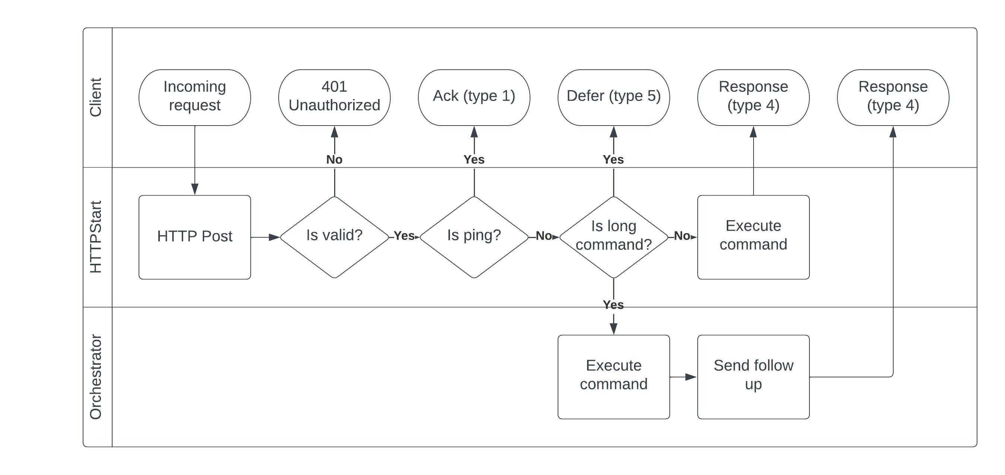

Slide 15
Azure Function code demo…

Slide 16
Creating a Discord Bot
Create Discord App
Bot -> Add bot
Oauth2 -> URL Generator ->
bot
application.commands
bot\send messages
Others as needed (none other needed for this demo)
Add HttpStart URI to Interactions Endpoint URL

Slide 17
Dealing with frostbite
PowerShell based Azure Functions have a long cold start
Monitor Function
Every 5m
Review Code

Slide 18
Full function code review…

Slide 19
Adding Commands

Slide 20
Command Types
Application (Global)
Applies to all servers
Slow propagation
Guild (Server)
Applies to a specific server
Instant propagation

Slide 21
Adding commands demo…

Slide 22
Building the bot yourself
Deploy ’03 – Function App’ folder to an existing Azure Function that is Linux PowerShell 7.2+ using VS Code
Create a bot in Discord, set the bot’s public key as a function app config item called: ‘DISCORD_PUBLIC_KEY’
Make sure the bot is warm and then copy HttpStart function url into the interactions URL for the bot.
Add the bot to a server by creating a URL and then navigating to it.
Create hello guild command
Run: /hello

